Slide 1
Welcome
.

Slide 2

Why this project
Are you looking for Tuitions or best tutors in your area!!!!! Don’t Worry!!
Tuition Corner is here !!!

Slide 3
TUTION CORNER
Learn. Teach. grow

Slide 4
Member Details
SEJAN, TAJVIR AHMED
KS SUBHAN MUNIM
AKTER, ROZINA
18-38557-2
NABIL, RAFSUN HUDA
18-38926-3
18-36151-1
18-36171-1

Slide 5

PROJECT OBJECTIVE
Now-a-days, tutors have to face a lot of difficulties in search of a tuition. Also In tuition pages they need to pay fees for the membership that doesn’t give any guarantee that they will get a tuition. Whereas , Parents want private tutors to help their children with better skills to perform better in exam. On the other hand, the university students of today are part of a generation that not only has an intense workload but also has to deal with extremely high costs of both living and tuition fees. Many pay their own university fees by working and with firms requiring qualifications that many students don’t have, tutoring school children is one of the most sought after options for university students. Seeing this need, we thought that if we make this application a quick search shows you thousands of qualified teachers. So Our aim is to build an application where Users who are searching for tuitions and those those who want tutor for their children will be provided. There will be available categories of tutors and tuitions. User can choose any of categories and apply for it. In our project there will be available details of tuitions ,tutor and students. User can search for best quality tutor and tuition according to their location. To access it user have to create an account of their own and login before enrollment.

Slide 6


How tuition corner works
Online Tutoring
Physical Tutoring

Slide 7
PROJECT DETAILS
USER
Admin
Functionalities
We tried to show our operations by a use case diagram below
Contribution
We tried to show our percentage of contribution using Jira software
Student
Tutor
Guardian

Slide 8
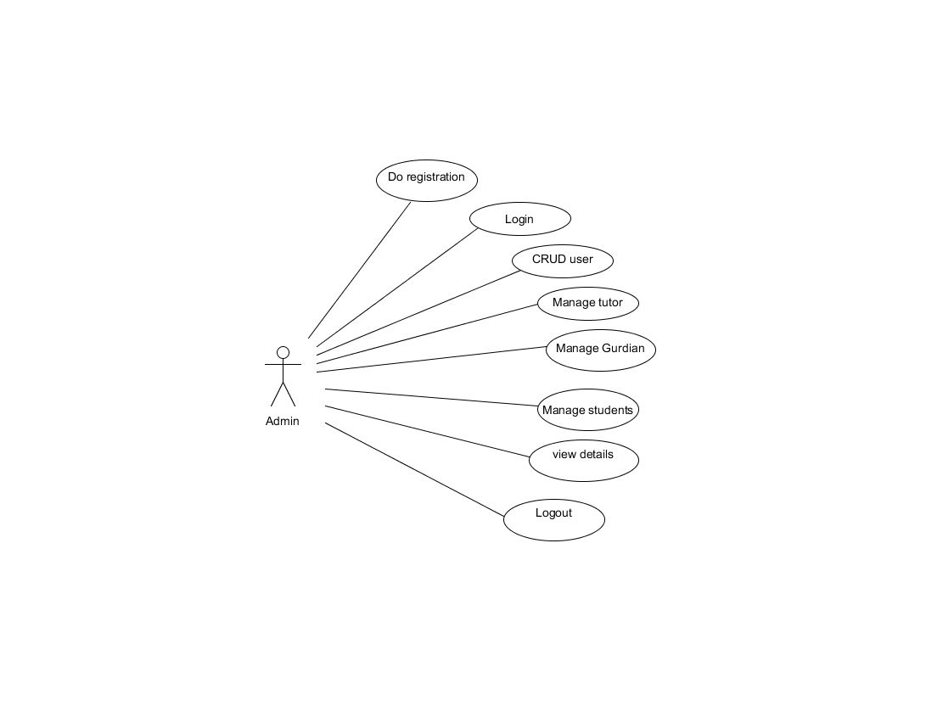
a
Admin
Manage Categories
Crud student
Crud tutor
Manage Students
Manage Tutors
Manage Payment
View Rating and reviews

Slide 9
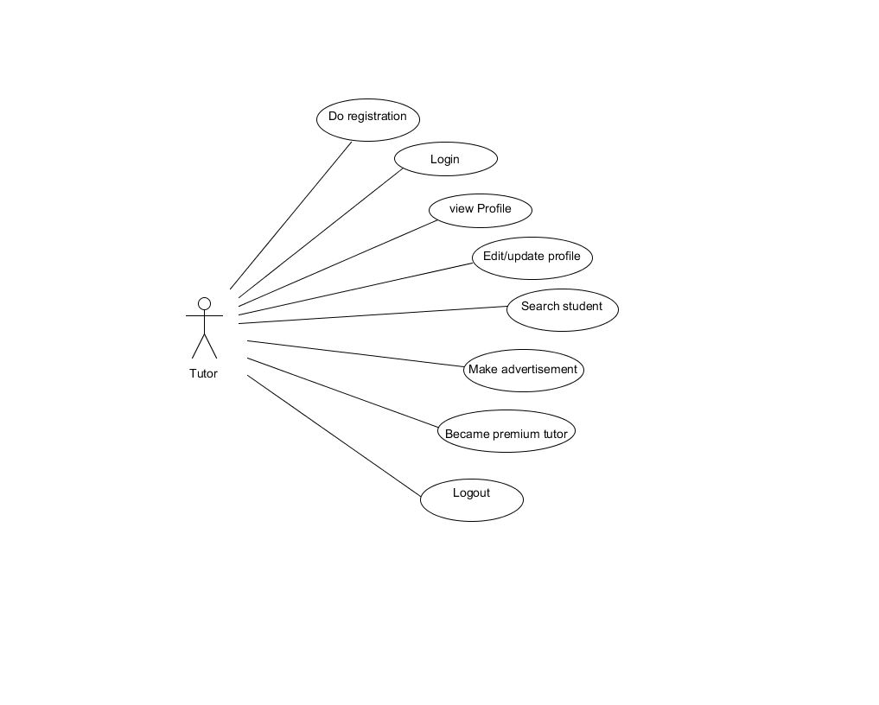
Tutor
Do Registration
Login
Edit profile
Search students
Update profile
Make Tuition Advertisement
Apply and became a premium tutor
Logout

Slide 10
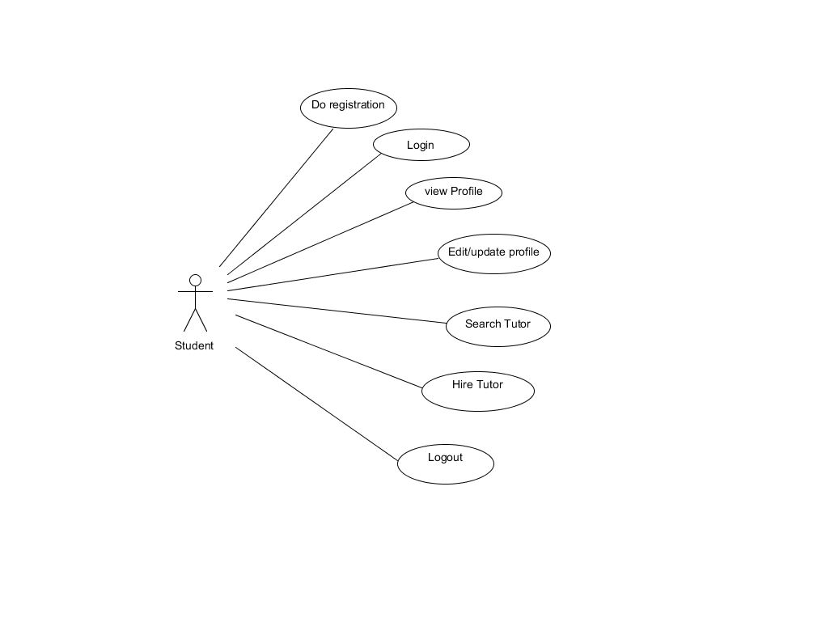
Student
Do registration
Login
Search for tutor
Hire tutor
Edit profile
Logout

Slide 11
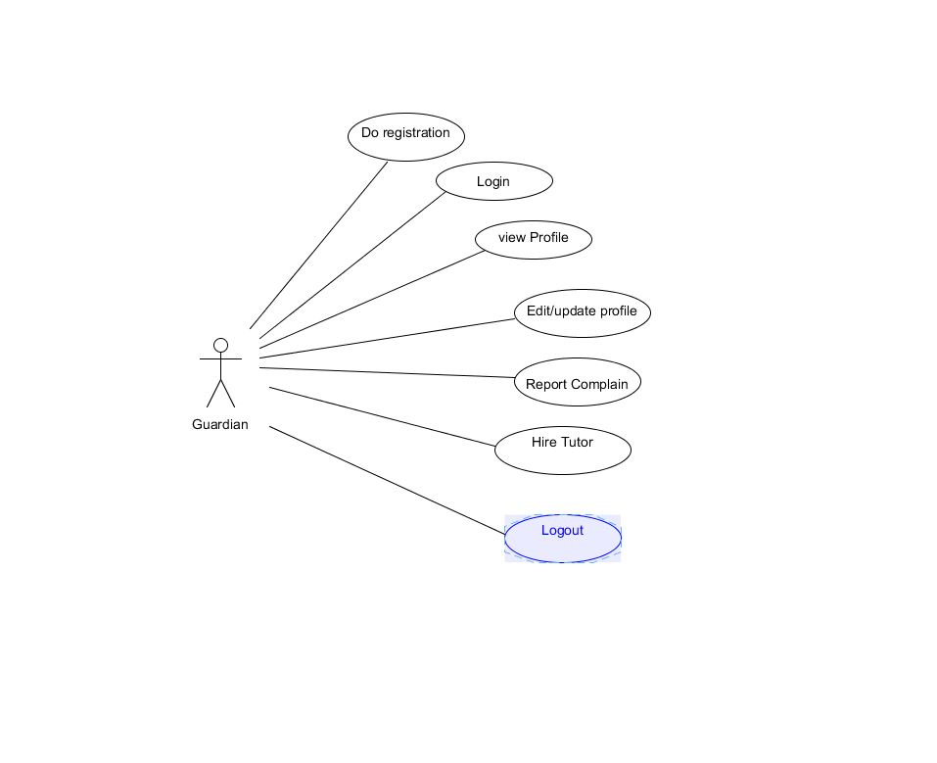
Guardian
LOGIN
Registration
Report Complain
Hire tutor
Edit n update profile
Logout

Slide 12
DESCRIPTION – Use Case Diagram
We tried to show the relationship between the actors using use case diagram. It describes the functionality and users of the system. In our application, we have 3 actors – Admin, Tutor, Student / Guardian. Each actor of our application have to login to access the application. The Admin can login , Crud tutor, Crud students and manage the whole system. The tutor can search for students, as per their location , update their profile, asset or reject request. On the other hand student can set their profile add requirements , search for tutor and hire a tutor. Tutor and student can also do registration in our application.

Slide 13
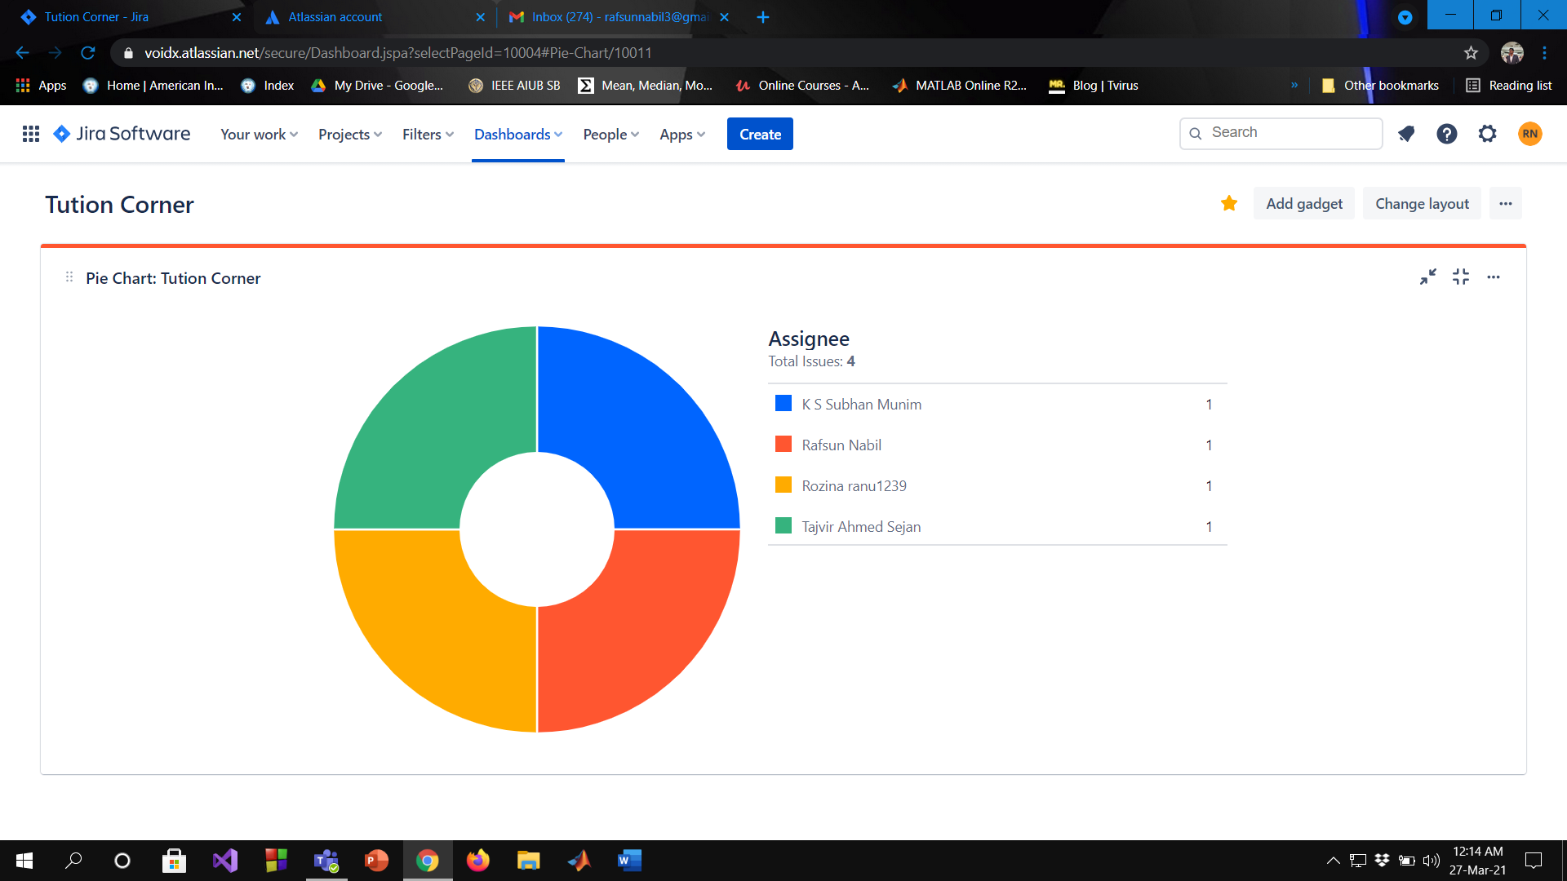
CONTRIBUTION

Slide 14
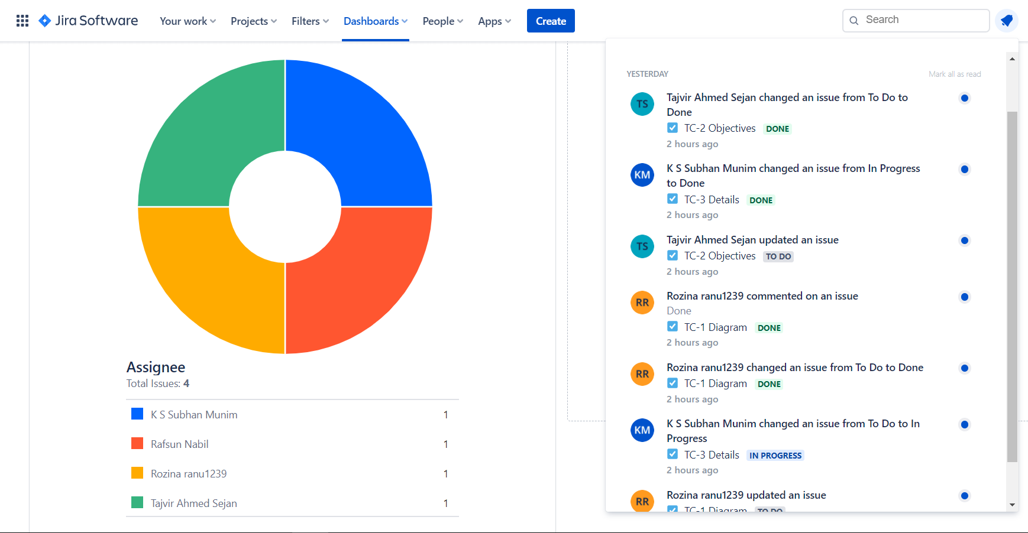
CONTRIBUTION

Slide 15
CONCLUSION
After developing this project we may reduce the difficulties of both teachers and students.

Slide 16


